Slide 1
DCDSL PROJECT AY 2024-25
Phase 2 Presentation
Title of the Project: OPTIMIZING E-COMMERCE BUSINESS OPERATION
Group Members:
NEIL CARDOZ (23070126079 9)
NIMIT PRAKASH (23070126082)
OM NARAYAN PANDIT (23070126083)
Practical Batch: B1
Subject Teacher
DR. ARCHANA CHAUDHRI
Department of Artificial Intelligence & Machine Learning
1

Slide 2

Outline of the Presentation
Names of all the group members and their work distribution
Introduction
Problem Statement
Objectives of the Project
Methodology
ER Diagram
ER Diagram To Relational Schema Conversion
Database Table Creation and Data Insertion
Basic and Advanced Query Implementation
Python Desktop / Web Application
Project Outcome
Conclusion
References
A photograph of the phase 1 presentation.
Department of Artificial Intelligence & Machine Learning
<number>

Slide 3
WORK DISTRIBUTION
Task | NEIL | NIMIT | OM
1. Project initialization | Selecting a topic and problem statement | Selecting the best data for the project | Searching for the data
2. Data Preparation | Initial data import to MySQL | Creating ER diagram and schema design | Downloading and preparing data
3. Database Set-up and Use | Make the MySQL database and inserted the data | Created the queries | Ran the queries and recorded the output
5. Data Analysis Queries | Writing queries for customer insights | Product and sales analysis queries | Review and feedback queries
4. Phase 1 | Final edit of the PPT | Reviewed and edited the PPT | Made the phase 1 PPT
4. Phase 2 | Made the phase 2 PPT | Made the phase 2 report | Made the ui for the database
Department of Artificial Intelligence & Machine Learning
<number>

Slide 4
Introduction
This project explores the Olist Brazilian eCommerce dataset, which offers a comprehensive look at consumer behavior, sales, and operations within Brazil's online marketplace.
Through data analysis and database modeling, we aim to generate insights that enhance eCommerce strategies.
This dataset, featuring thousands of orders, customer reviews, geolocation data, and sales transactions, allows for a deep dive into customer preferences, product demand, and operational trends.
Our project focuses on creating a robust database system for efficient data storage and retrieval, with the ultimate goal of providing actionable insights to optimize online retail performance.
10/11/2024
Department of Artificial Intelligence & Machine Learning
4

Slide 5
PROBLEM STATEMENT
The eCommerce industry in Brazil has experienced rapid growth, driven by increasing internet penetration and evolving consumer behavior. However, online retailers face significant challenges related to customer satisfaction, order management, sales optimization, and effective use of data to improve services. The vast amount of data generated by eCommerce transactions needs to be efficiently stored, analyzed, and visualized to derive actionable insights.
This project aims to design and implement a local MySQL database based on the Olist Brazilian eCommerce dataset to address these challenges. By organizing data into relational structures, analyzing customer behaviors, and visualizing sales patterns, the project seeks to enhance operational efficiency and customer satisfaction.
Furthermore, a user-friendly UI will be developed to interact seamlessly with the database, enabling intuitive data access, query execution, and meaningful data visualization.
10/11/2024
Department of Artificial Intelligence & Machine Learning
5

Slide 6
Objectives of the Project
1. Develop and Optimize Queries for Data Analysis
Write and fine-tune SQL queries for comprehensive analysis of customer behaviors, product sales, orders, payments, and reviews.
Optimize query performance through indexing and other techniques to ensure fast data retrieval and processing.
Develop complex queries for business insights, such as top-selling products, regional trends, and customer segmentation.
2. Create a User-Friendly UI for Data Interaction
Design and build an intuitive user interface (UI) to enable seamless interaction with the MySQL database.
Include easy-to-navigate features such as tabs, menus, and search functions to access and manipulate data.
10/11/2024
Department of Artificial Intelligence & Machine Learning
6

Slide 7
Objectives of the Project
3. Create and Use Functions and Stored Procedures
Develop stored functions for common data operations to enhance re usability and maintainability of database logic.
Write stored procedures for complex operations, such as aggregating sales data, customer segmentation, and order fulfilment summaries.
Call functions and procedures directly from the UI to perform data manipulations in an efficient manner.
4. Implement Database Triggers for Automation
Create triggers to automatically handle specific database events (e.g., updating order statuses when payments are processed).
Use triggers to enforce business rules, maintain data integrity, and perform automatic logging of critical operations.
10/11/2024
Department of Artificial Intelligence & Machine Learning
7

Slide 8
Methodology for the Project
1. Data Collection and Preparation
Dataset Selection: The project uses the Olist Brazilian eCommerce dataset, which includes transactional data from a Brazilian eCommerce platform, covering customer orders, product details, reviews, payments, and geolocation.
2. Database Design
Schema Design: Analyze the data to determine the relationships between different entities (e.g., customers, orders, products, payments, reviews).
Table Creation: Using MySQL, create tables based on the schema, with primary keys for each table and foreign keys to represent relationships between them (e.g., linking orders to customers and products).
10/11/2024
Department of Artificial Intelligence & Machine Learning
8

Slide 9
Methodology for the Project
3. Query Development
SQL Queries: Write SQL queries to retrieve meaningful insights from the database, such as:
Customer Insights: Find the top customers by purchase volume, or segment customers by regions or product preferences.
Sales Analysis: Identify top-selling products, trends in sales over time, and analyze payment methods.
Order and Payment Tracking: Monitor order statuses and payment methods, and analyze transaction times or shipping delays.
Query Optimization: Optimize queries using joins, subqueries, and grouping to ensure fast and accurate results.
10/11/2024
Department of Artificial Intelligence & Machine Learning
9

Slide 10
Methodology for the Project
4. User Interface (UI) Development
UI Design: Design the UI with a focus on user experience. Create wireframes to define the layout and flow of the interface.
UI-Database Integration: Connect the UI to the MySQL database using a server-side language (e.g., PHP, Node.js, or Python) to send SQL queries and receive the results for display.
5. Testing and Debugging
Unit Testing: Test individual SQL queries, functions, and stored procedures to ensure they are working as expected.
UI Testing: Conduct usability testing on the UI to ensure it is intuitive, responsive, and free of bugs. Test the UI’s ability to interact with the database and display accurate data.
Database Integrity Testing: Verify that the data in the database is consistent, and the relationships between tables are maintained.
10/11/2024
Department of Artificial Intelligence & Machine Learning
10

Slide 11
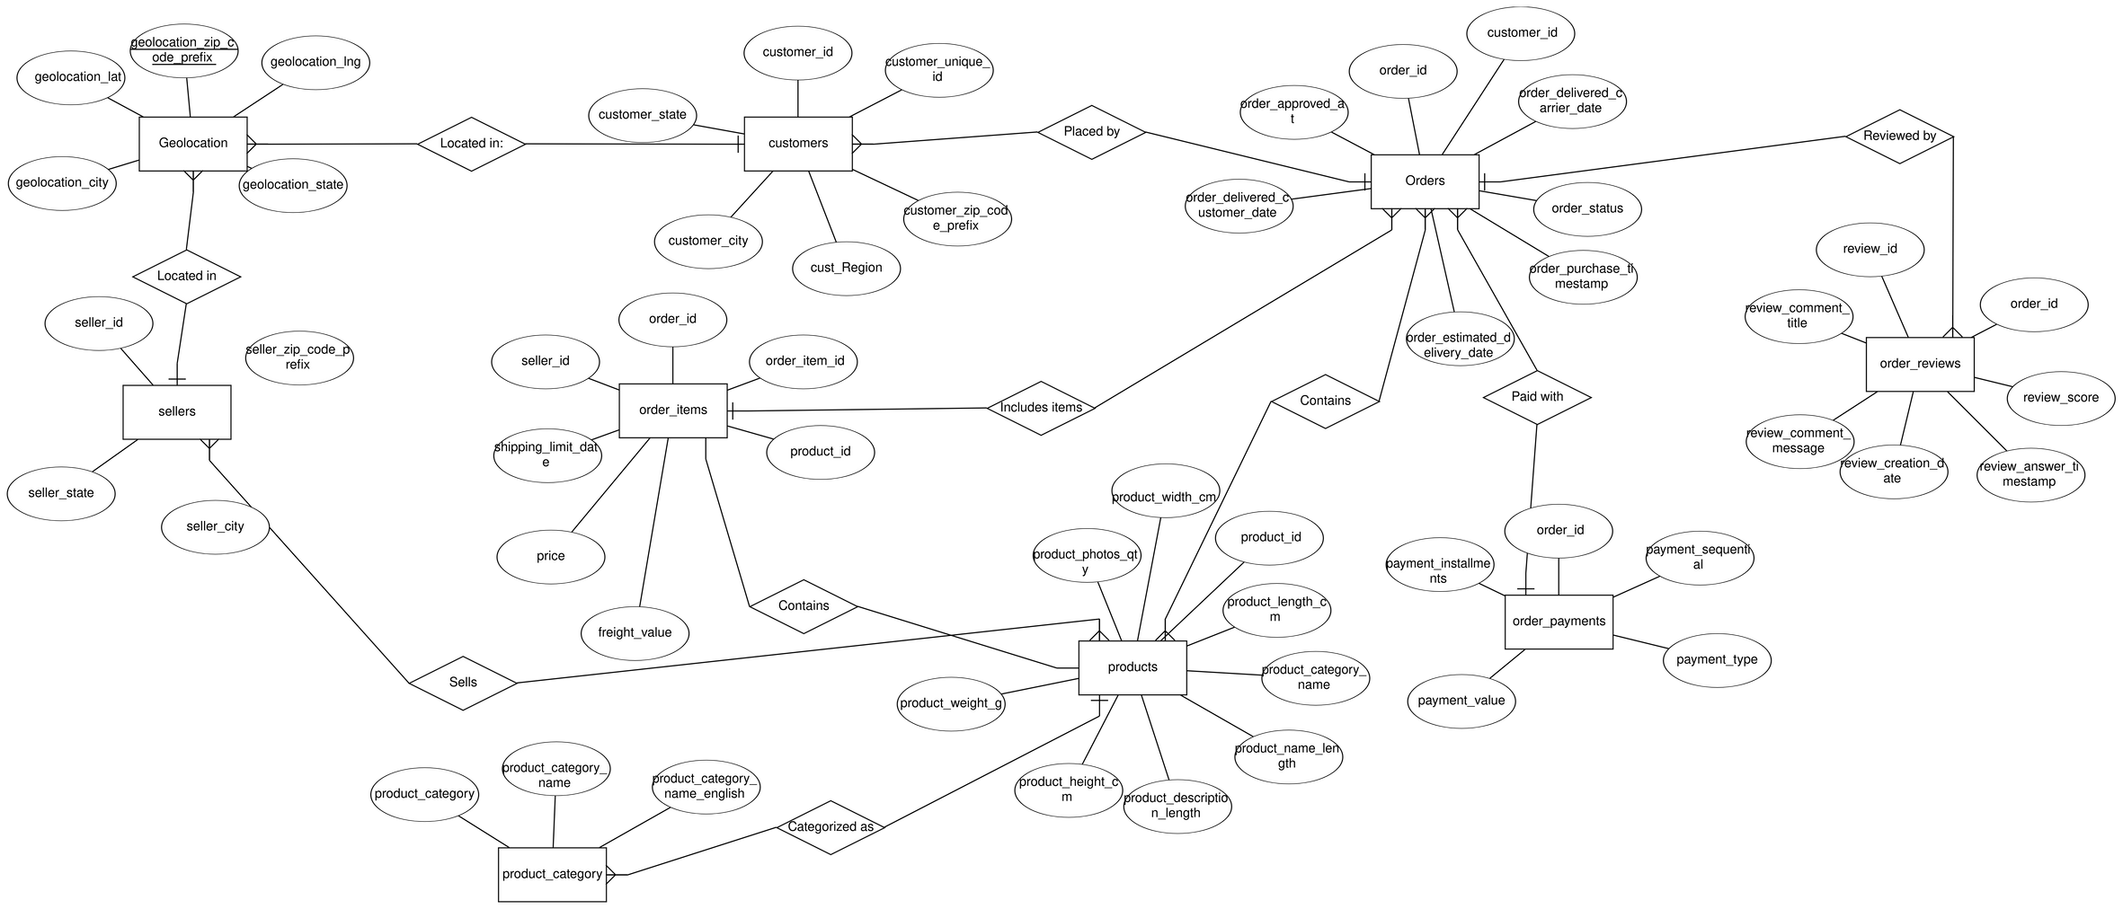
ER Diagram
10/11/2024
Department of Artificial Intelligence & Machine Learning
11

Slide 12
ER Diagram To Relational Schema Conversion
geolocation_dataset (geolocation_zip_code_prefix, geolocation_lat, geolocation_lng, geolocation_city, geolocation_state)
customers_dataset (customer_id, customer_unique_id, customer_zip_code_prefix, customer_city, customer_state, cust_Region)
sellers_dataset (seller_id, seller_zip_code_prefix, seller_city, seller_state)
product_category (product_category_name, product_category_name_english, product_category)
products_dataset (product_id, product_category_name, product_name_length, product_description_length, product_photos_qty, product_weight_g, product_length_cm, product_height_cm, product_width_cm)
10/11/2024
Department of Artificial Intelligence & Machine Learning
12

Slide 13
ER Diagram To Relational Schema Conversion
orders_dataset (order_id, customer_id, order_status, order_purchase_timestamp, order_approved_at, order_delivered_carrier_date, order_delivered_customer_date, order_estimated_delivery_date)
order_reviews_dataset (review_id, order_id, review_score, review_comment_title, review_comment_message, review_creation_date, review_answer_timestamp)
order_items_dataset (order_id, order_item_id, product_id, seller_id, shipping_limit_date, price, freight_value)
order_payments_dataset (order_id, payment_sequential, payment_type, payment_installments, payment_value)
10/11/2024
Department of Artificial Intelligence & Machine Learning
13

Slide 14
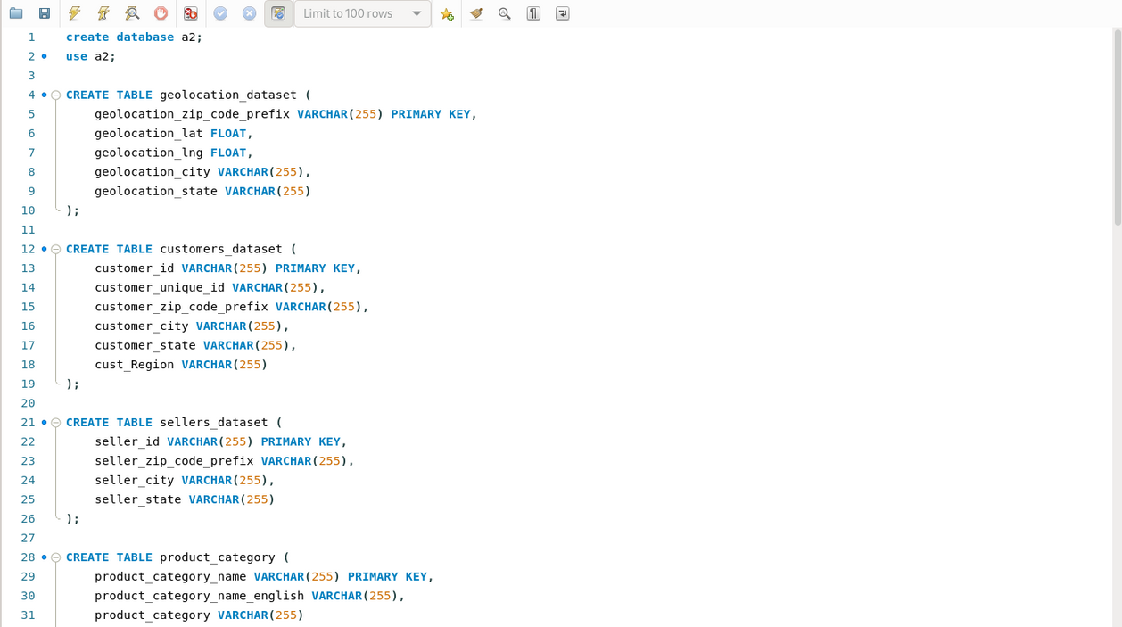
Database Table Creation
10/11/2024
Department of Artificial Intelligence & Machine Learning
14

Slide 15
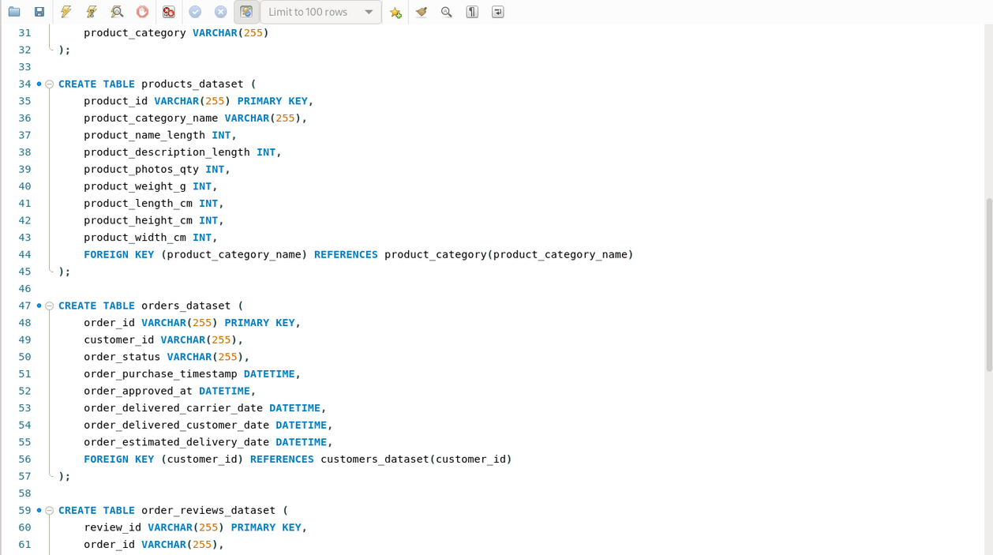
Database Table Creation
10/11/2024
Department of Artificial Intelligence & Machine Learning
15

Slide 16
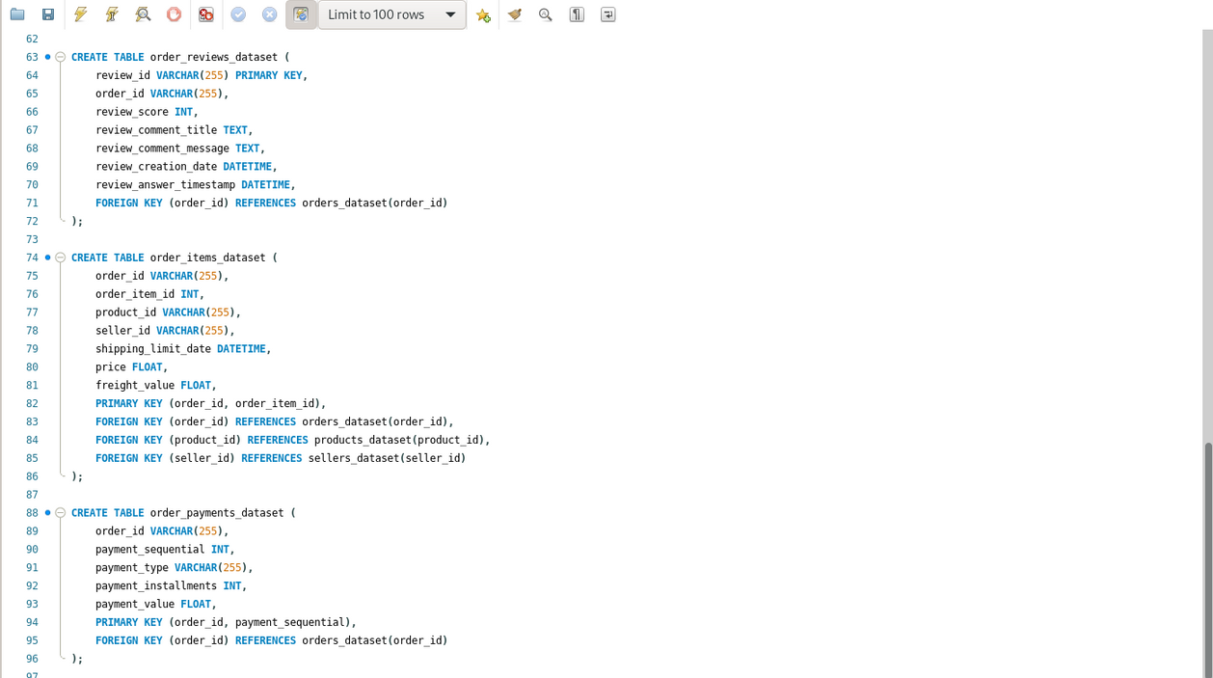
Database Table Creation
10/11/2024
Department of Artificial Intelligence & Machine Learning
16

Slide 17
Data Insertion
In this project, I utilized the CSV Insert Tool to efficiently populate the MySQL database with data.
The CSV Insert Tool allows for bulk importing of data from CSV files into MySQL tables, which significantly speeds up the process of inserting large datasets.
I prepared the data in CSV format, ensuring that it adhered to the required schema, and then used the tool to map the columns in the CSV files to the corresponding columns in the MySQL tables.
This method streamlined the data import process, ensuring accuracy and consistency across the database while minimizing manual data entry.
10/11/2024
Department of Artificial Intelligence & Machine Learning
17

Slide 18
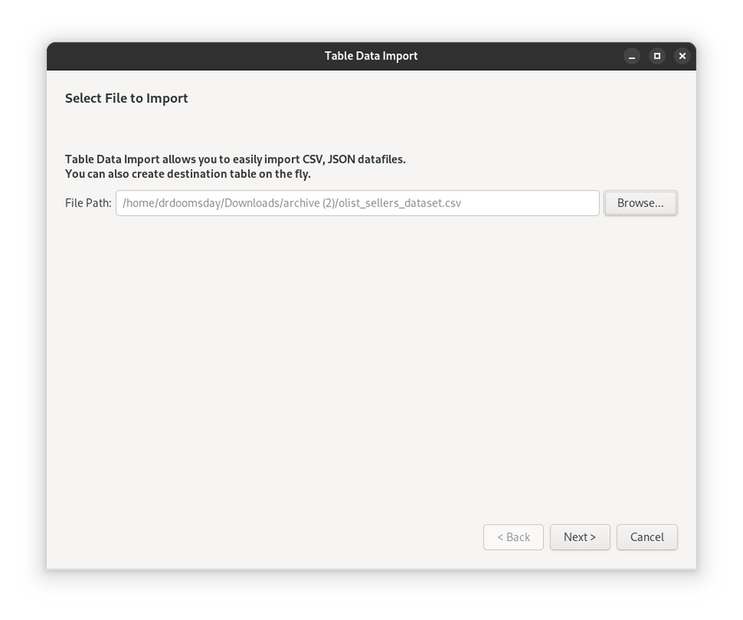
Data Insertion
10/11/2024
Department of Artificial Intelligence & Machine Learning
18

Slide 19
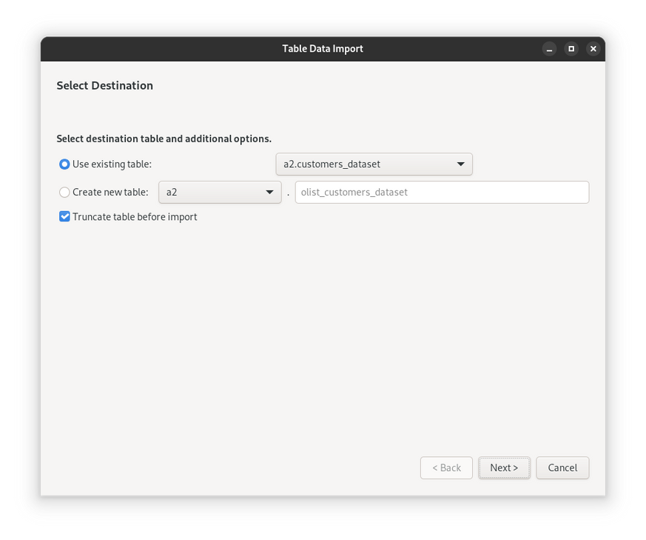
Data Insertion
10/11/2024
Department of Artificial Intelligence & Machine Learning
19

Slide 20
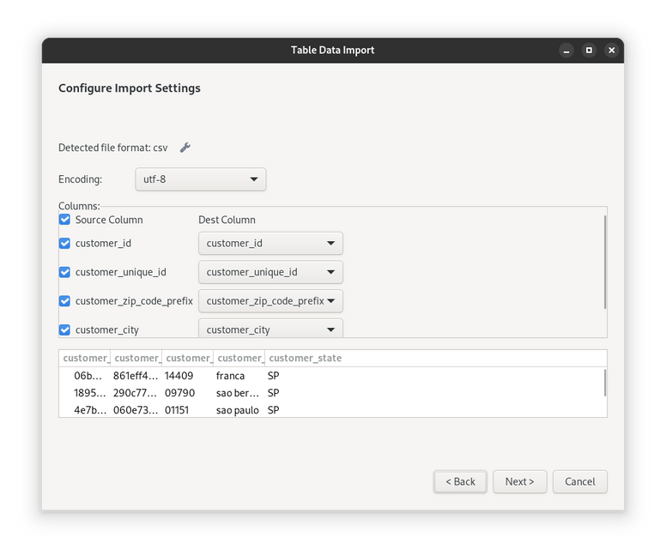
Data Insertion
10/11/2024
Department of Artificial Intelligence & Machine Learning
20

Slide 21
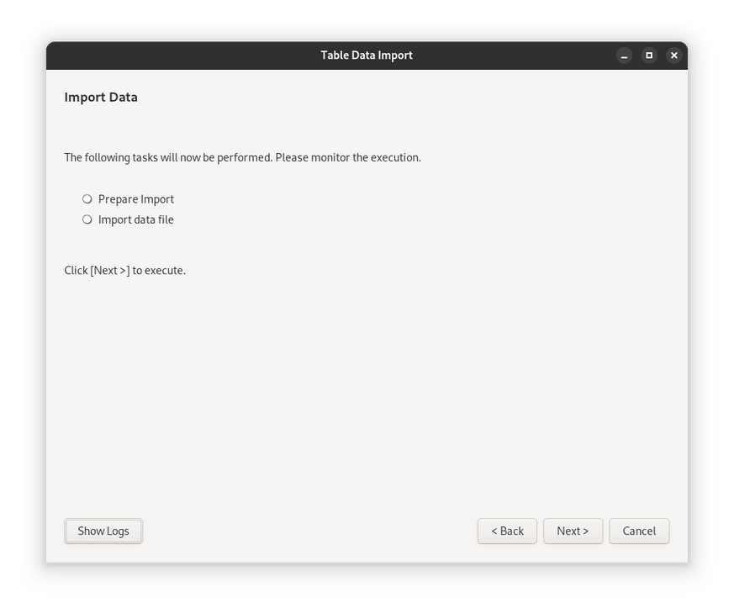
Data Insertion
10/11/2024
Department of Artificial Intelligence & Machine Learning
21

Slide 22
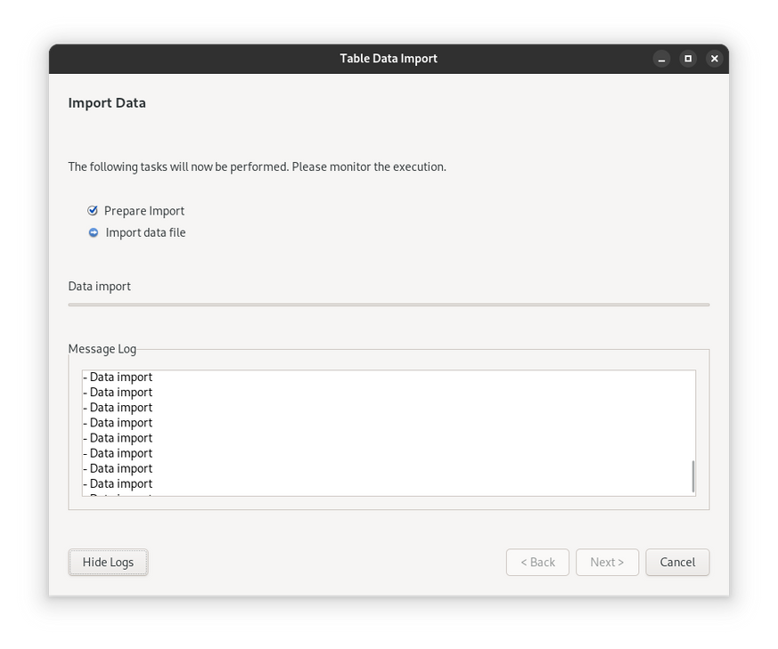
Data Insertion
10/11/2024
Department of Artificial Intelligence & Machine Learning
22

Slide 23
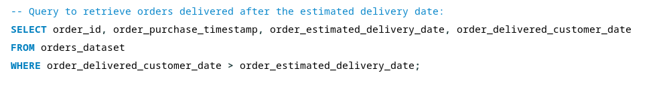
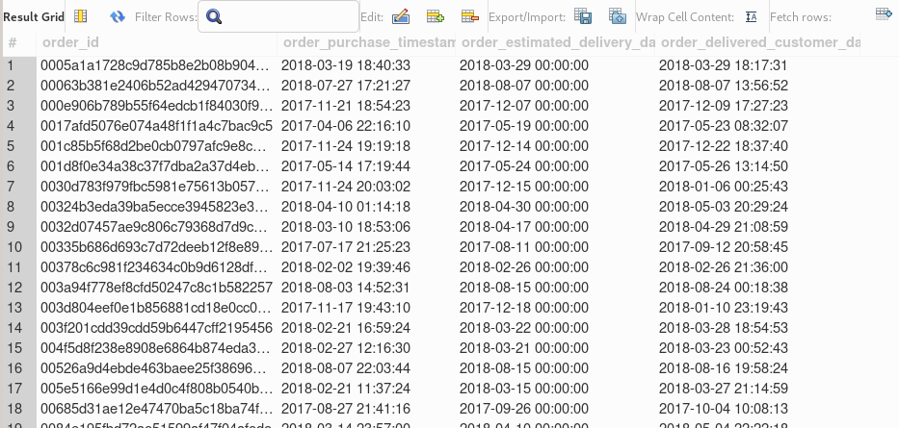
Query Implementation
10/11/2024
Department of Artificial Intelligence & Machine Learning
23

Slide 24
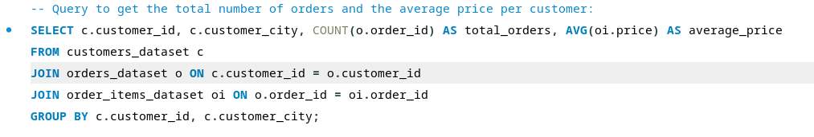
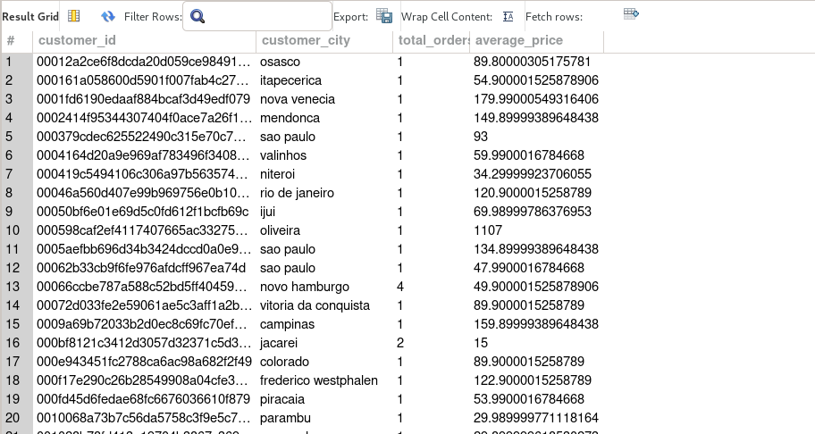
Query Implementation
10/11/2024
Department of Artificial Intelligence & Machine Learning
23

Slide 25
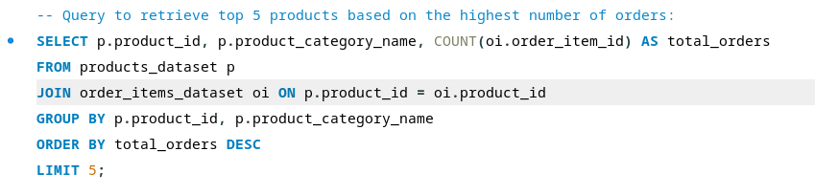
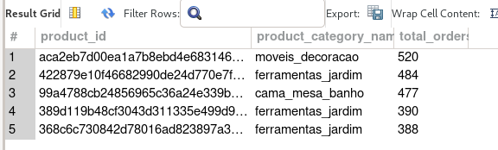
Query Implementation
10/11/2024
Department of Artificial Intelligence & Machine Learning
23

Slide 26
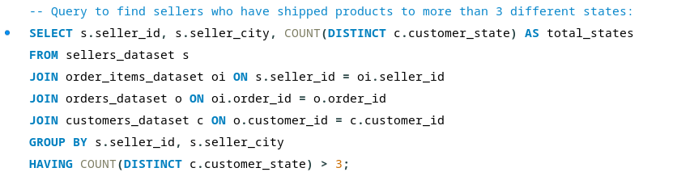
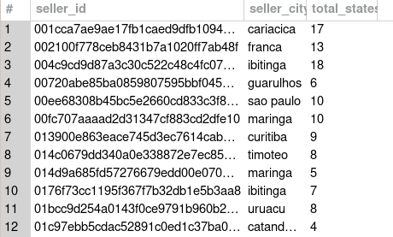
Query Implementation
10/11/2024
Department of Artificial Intelligence & Machine Learning
23

Slide 27
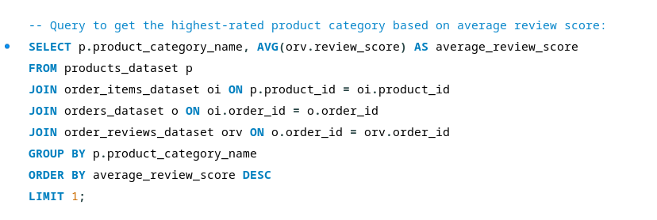

Query Implementation
10/11/2024
Department of Artificial Intelligence & Machine Learning
23

Slide 28
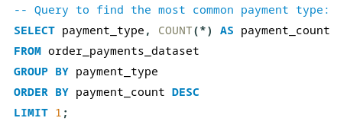

Query Implementation
10/11/2024
Department of Artificial Intelligence & Machine Learning
23

Slide 29
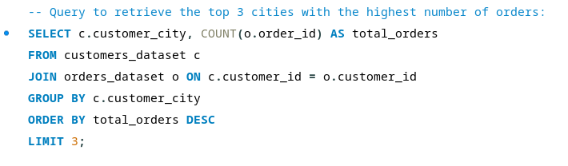

Query Implementation
10/11/2024
Department of Artificial Intelligence & Machine Learning
23

Slide 30
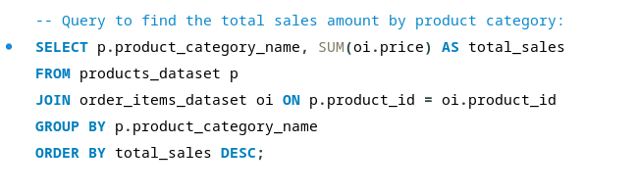
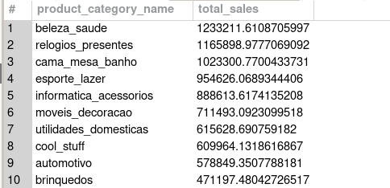
Query Implementation
10/11/2024
Department of Artificial Intelligence & Machine Learning
23

Slide 31
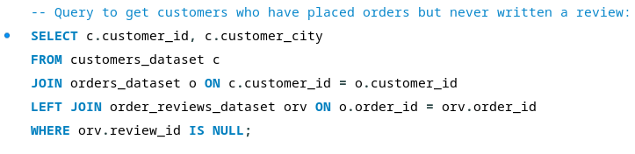
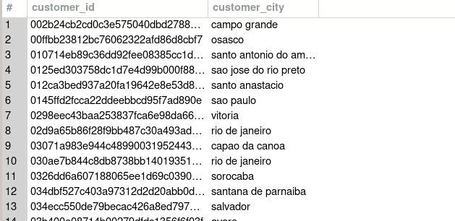
Query Implementation
10/11/2024
Department of Artificial Intelligence & Machine Learning
23

Slide 32
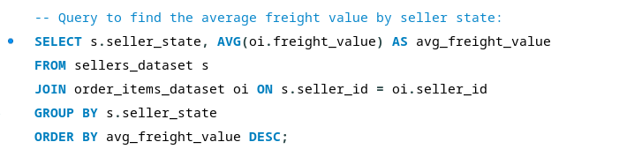
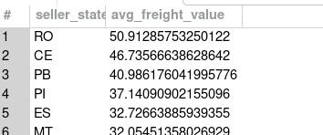
Query Implementation
10/11/2024
Department of Artificial Intelligence & Machine Learning
23

Slide 33
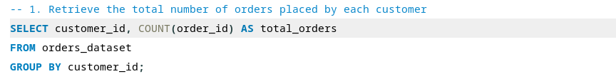
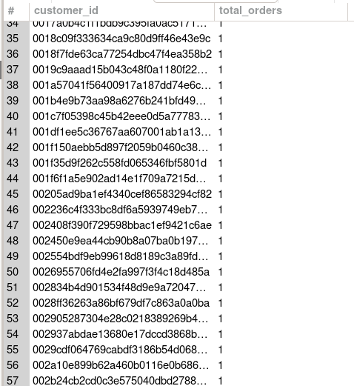
Query Implementation
10/11/2024
Department of Artificial Intelligence & Machine Learning
23

Slide 34
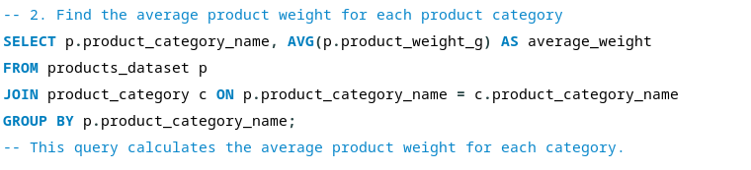
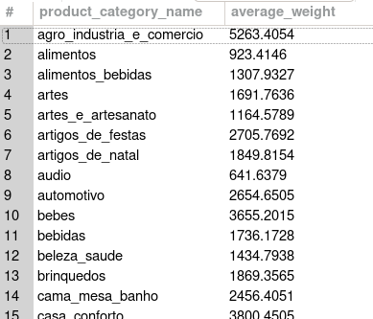
Query Implementation
10/11/2024
Department of Artificial Intelligence & Machine Learning
23

Slide 35
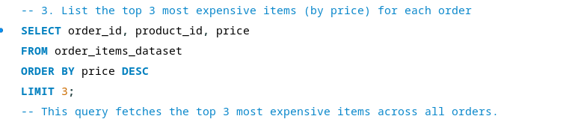
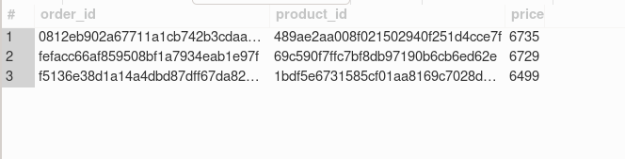
Query Implementation
10/11/2024
Department of Artificial Intelligence & Machine Learning
23

Slide 36
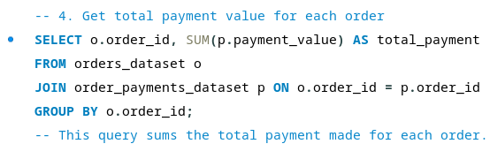
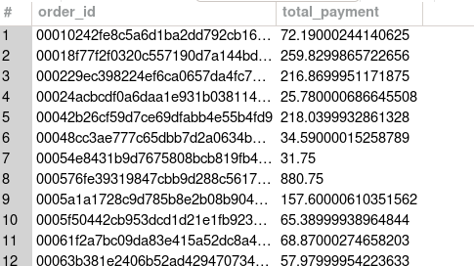
Query Implementation
10/11/2024
Department of Artificial Intelligence & Machine Learning
23

Slide 37
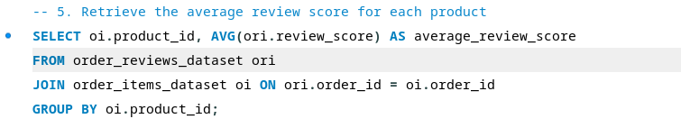
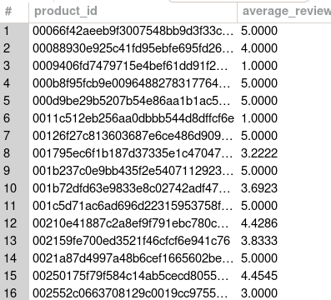
Query Implementation
10/11/2024
Department of Artificial Intelligence & Machine Learning
23

Slide 38
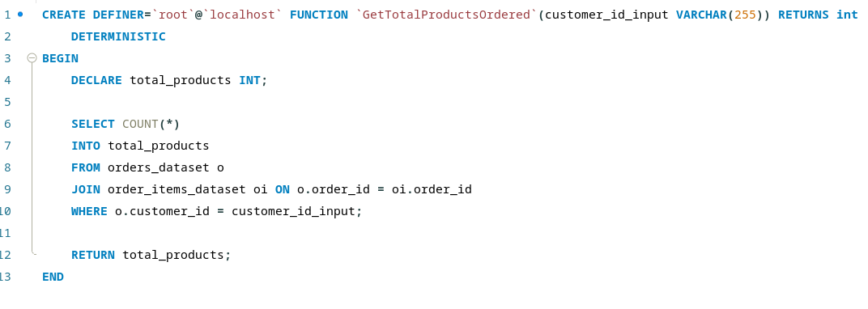

Query Implementation
10/11/2024
Department of Artificial Intelligence & Machine Learning
23

Slide 39
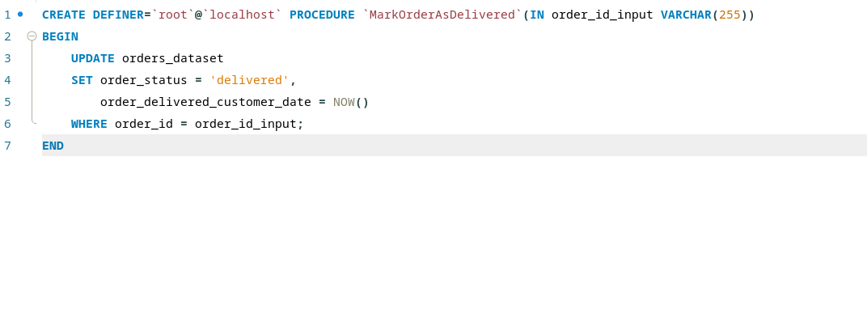
Query Implementation
10/11/2024
Department of Artificial Intelligence & Machine Learning
23

Slide 40
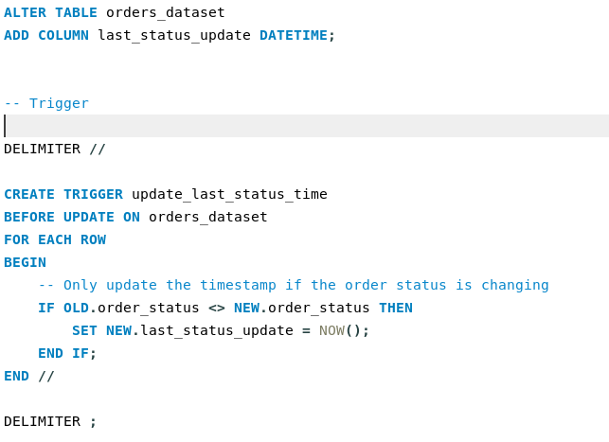
Query Implementation
10/11/2024
Department of Artificial Intelligence & Machine Learning
23

Slide 41
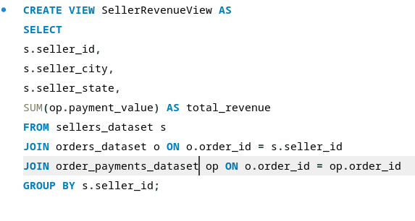
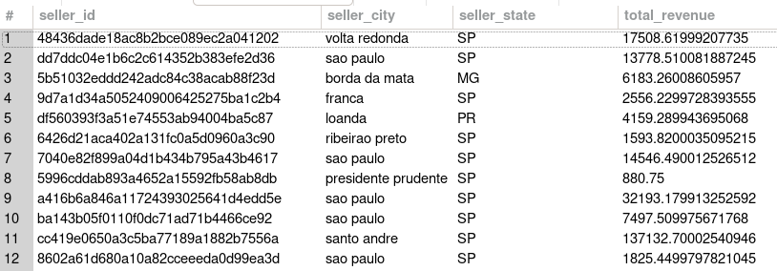
Query Implementation
10/11/2024
Department of Artificial Intelligence & Machine Learning
23

Slide 42
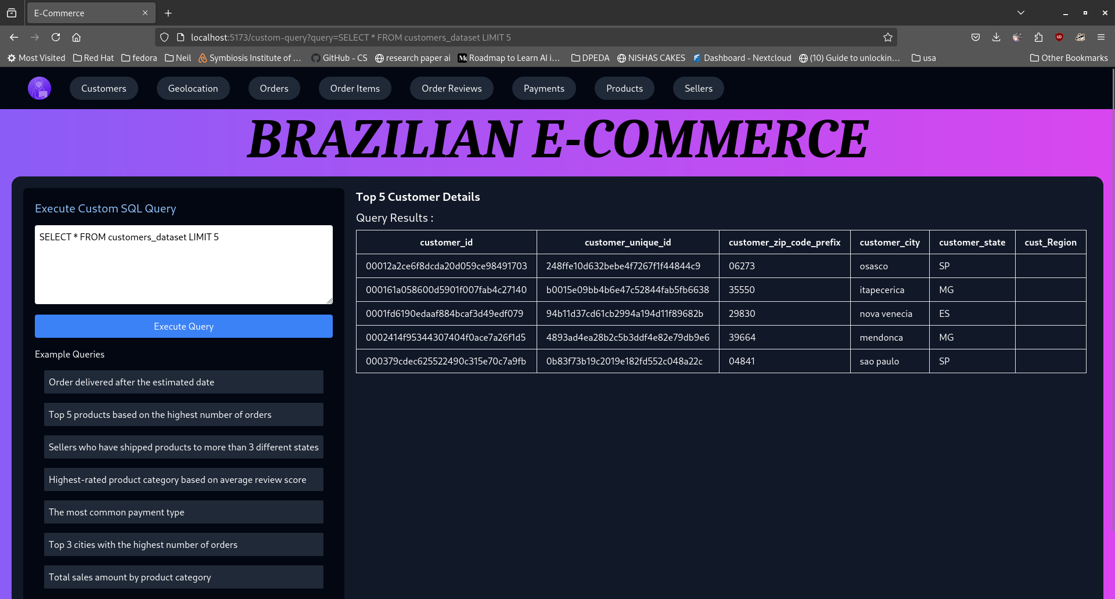
Web Application
Used React and Node.js
10/11/2024
Department of Artificial Intelligence & Machine Learning
20

Slide 43
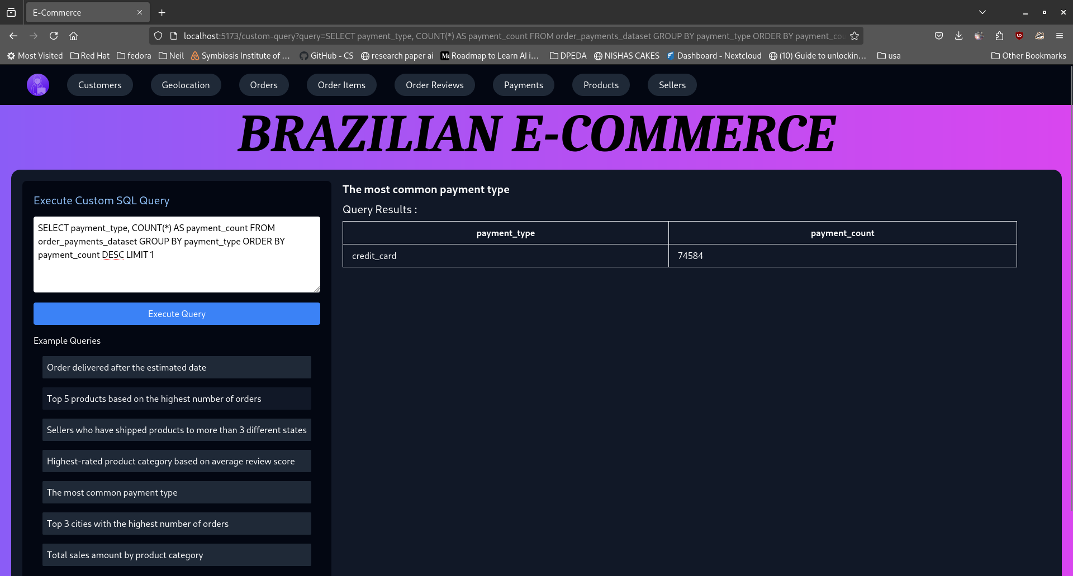
Web Application
10/11/2024
Department of Artificial Intelligence & Machine Learning
20

Slide 44
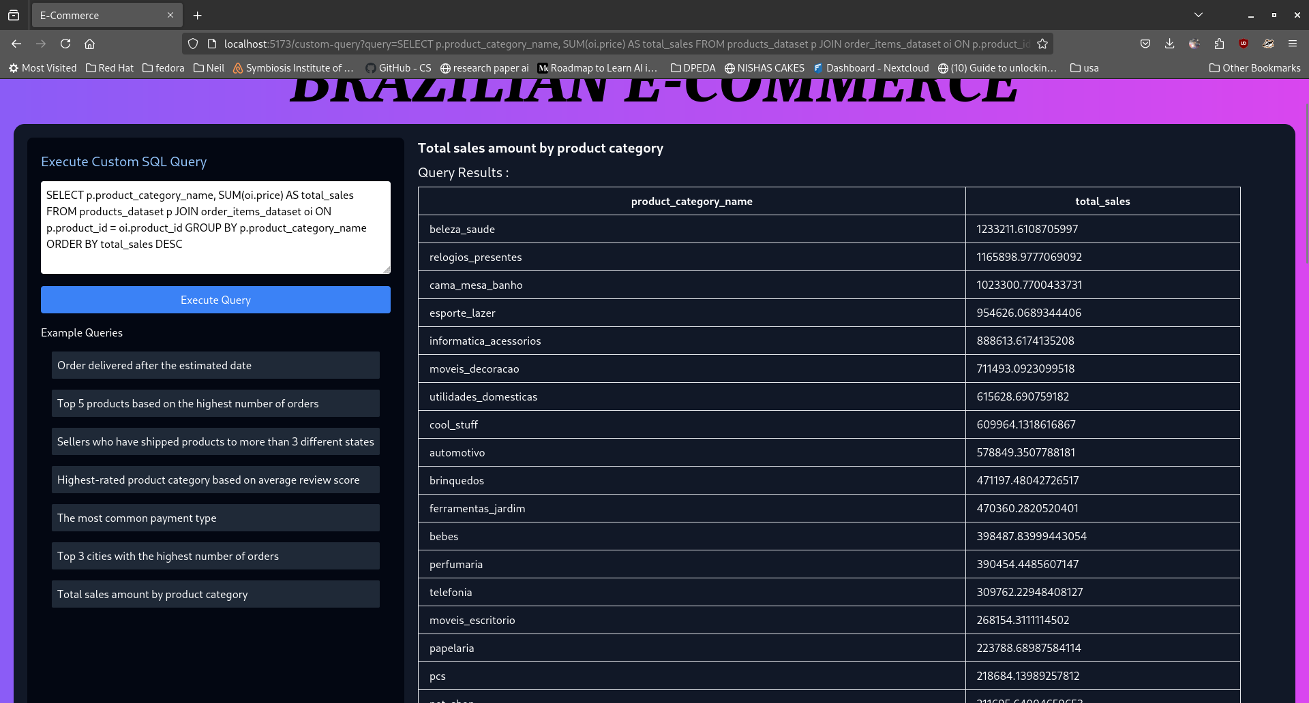
Web Application
10/11/2024
Department of Artificial Intelligence & Machine Learning
20

Slide 45
Web Application
10/11/2024
Department of Artificial Intelligence & Machine Learning
20

Slide 46
Project Outcome
Comprehensive Database System
A fully functional MySQL database designed to efficiently store, manage, and query the Brazilian eCommerce dataset
2. Optimized Queries for Data Analysis
Well-structured SQL queries for analyzing key metrics such as customer behaviors, order trends, payment methods, and product performance.
3. User-Friendly Interface
An intuitive user interface (UI) that provides seamless access to the database, enabling users to easily query, update, and view data without direct interaction with the raw database.
10/11/2024
Department of Artificial Intelligence & Machine Learning
20

Slide 47
Project Outcome
Comprehensive Database System
A fully functional MySQL database designed to efficiently store, manage, and query the Brazilian eCommerce dataset
2. Optimized Queries for Data Analysis
Well-structured SQL queries for analyzing key metrics such as customer behaviors, order trends, payment methods, and product performance.
3. User-Friendly Interface
An intuitive user interface (UI) that provides seamless access to the database, enabling users to easily query, update, and view data without direct interaction with the raw database.
10/11/2024
Department of Artificial Intelligence & Machine Learning
20

Slide 48
Project Outcome
Comprehensive Database System
A fully functional MySQL database designed to efficiently store, manage, and query the Brazilian eCommerce dataset
2. Optimized Queries for Data Analysis
Well-structured SQL queries for analyzing key metrics such as customer behaviors, order trends, payment methods, and product performance.
3. User-Friendly Interface
An intuitive user interface (UI) that provides seamless access to the database, enabling users to easily query, update, and view data without direct interaction with the raw database.
10/11/2024
Department of Artificial Intelligence & Machine Learning
20

Slide 49
Project Outcome
4. Improved Data Management Capabilities
Functions, procedures, and triggers implemented for automatic handling of database events, efficient data management, and maintaining data consistency and integrity.
5. Actionable Insights
Enhanced ability to derive insights from the data, enabling better decision-making related to customer engagement, sales optimization, and business growth strategies.
10/11/2024
Department of Artificial Intelligence & Machine Learning
20

Slide 50
Project Outcome
The successful completion of this project demonstrates the integration of data management, analytical processing, and user-centric design to provide a comprehensive solution for the Brazilian eCommerce dataset. By developing a robust MySQL database and an intuitive user interface, we enabled efficient data storage, access, and analysis, empowering users to derive actionable insights with ease.
The inclusion of optimized queries, functions, procedures, and triggers ensures streamlined operations and consistent data integrity, enhancing the database’s performance and utility. Through visualizations and interactive UI elements, complex data patterns are made more comprehensible, supporting informed decision-making.
This project not only showcases practical skills in database management and user interface development but also lays a strong foundation for scalable, data-driven applications in the eCommerce domain. It serves as a valuable tool for businesses seeking to understand customer behaviors, optimize sales strategies, and adapt to dynamic market demands, ultimately promoting data-driven growth and improved operational efficiency.
10/11/2024
Department of Artificial Intelligence & Machine Learning
20

Slide 51
Conclusion
To summarize, we’ve discussed the structure of our Brazilian e-commerce data in a relational database. This setup not only makes the data easy to manage but also allows us to extract valuable insights that can drive business strategies and improve customer satisfaction.
10/11/2024
Department of Artificial Intelligence & Machine Learning
20

Slide 52
References
Elmasri, R., & Navathe, S. B. - Fundamentals of Database Systems (7th ed.).
Silberschatz, A., Korth, H. F., & Sudarshan, S. - Database System Concepts (7th ed.).
Connolly, T., & Begg, C. - Database Systems: A Practical Approach to Design, Implementation, and Management (6th ed.).
Krishna, A. - E-Commerce Database Management System Design Patterns and Optimizations.
Lal, S., & Saini, R. - Performance Optimization Techniques in Relational Database Management Systems..
10/11/2024
Department of Artificial Intelligence & Machine Learning
20

